Slide 1

EDA
with Josh Gieringer

Slide 2
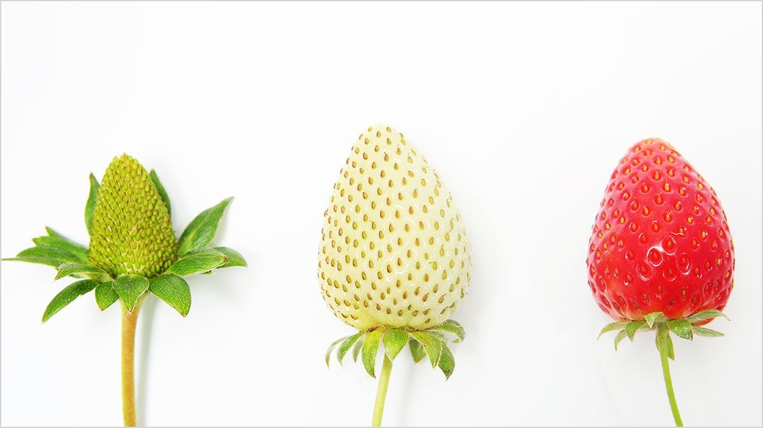

Slide 3

Notes:
1. Initial (A client has some data that they are interested in tapping into for future solutions, but aren't quite sure of all the gold (pic of something awesome) -- or fools' gold (pic of some shit) -- that lies within)
i. This answers questions about whether the data is good enough for modeling and that a solution is feasible.
When a client comes to me to perform modeling of some type, -- classification, mainly -- runway rarely (show pic of modeling runway) split screen of log reg and runway model,
We must first have an understanding of the data we're working with. Most of the time, a client doesn't even have labels, maybe a few examples of hits, so we must infer our own to gain insight if the project is feasible to actually go through with in a certain timeline... To mimic the process, we'll be looking at a dataset without labels.

Slide 4


Pic of handing over data

Slide 5

Pic of gold and diamonds

Slide 6
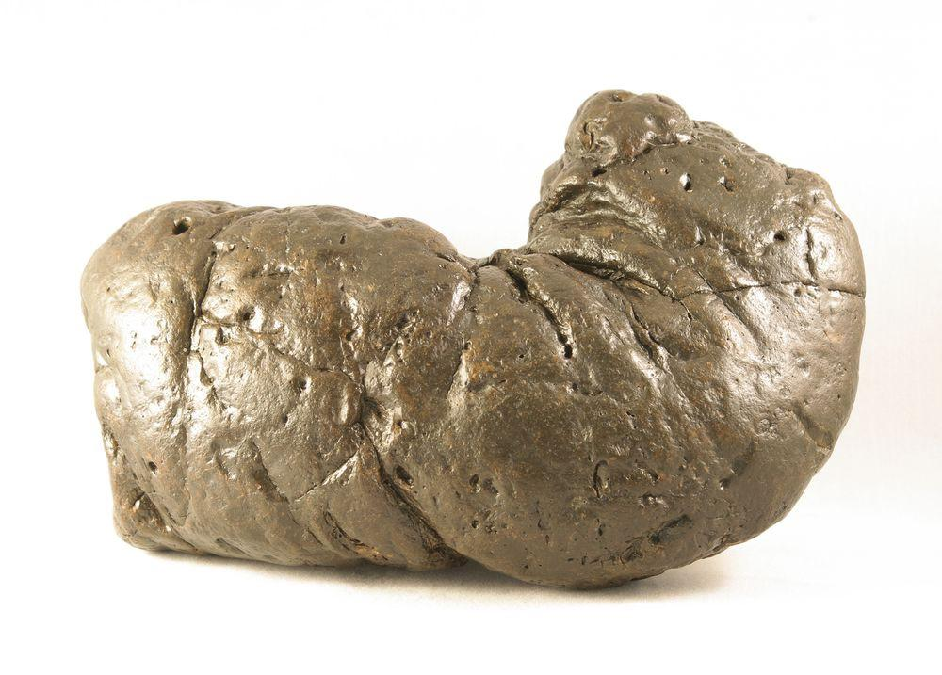
Pic of shit
Notes:
coprolite

Slide 7
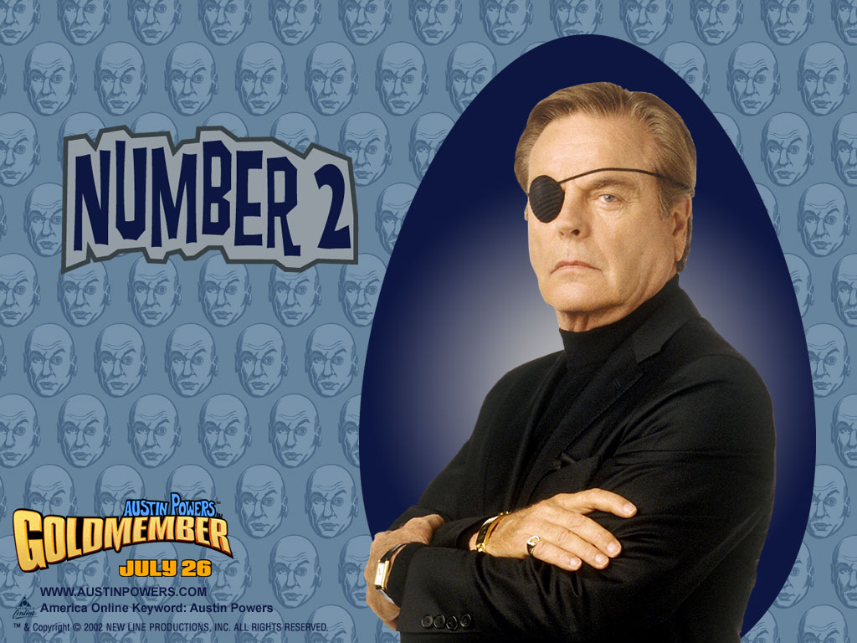
2. Pre-to-mid modeling
Notes:
2. Pre-to-mid modeling (Initial EDA is good. I have sat with a SME, and we have come up with Targets/Labels for our models. We want to visualize what our development set is looking like. How balanced is our dataset with respect to the targets, etc.)
i. This answers questions regarding the models we might initially choose for our solution. This gives us approximations on what features to trust (feature selection), the balance of the dataset with respect to the targets, and how to treat the features with respect to the balance of the dataset targets (ft. weighting)

Slide 8
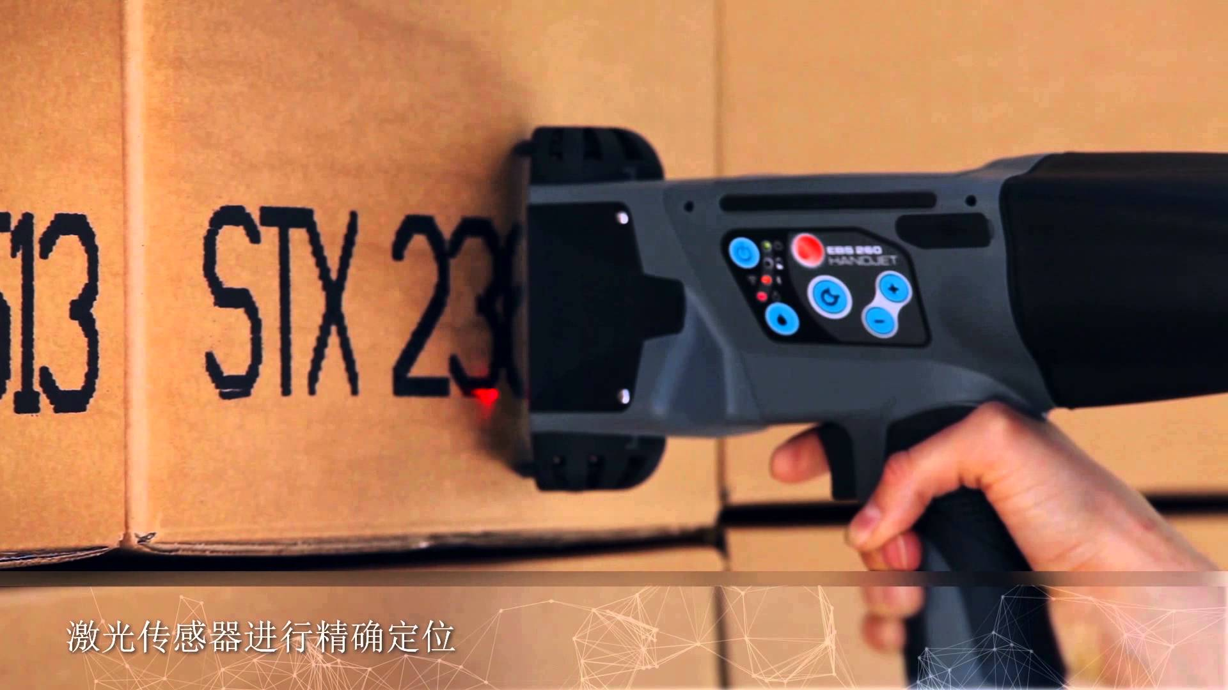
We have targets

Slide 9
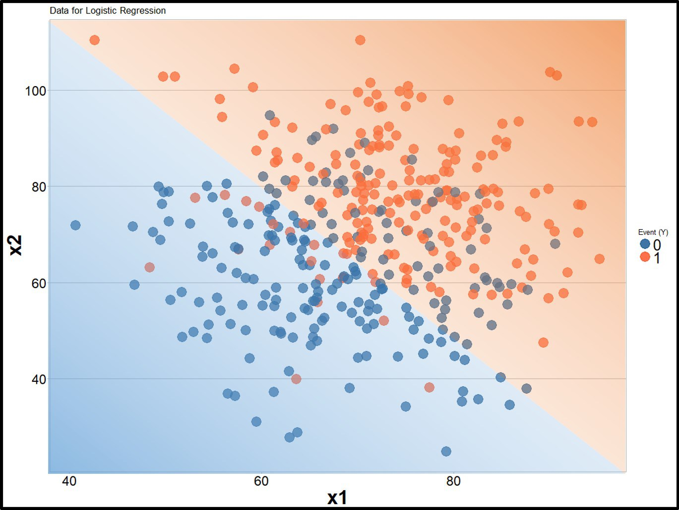
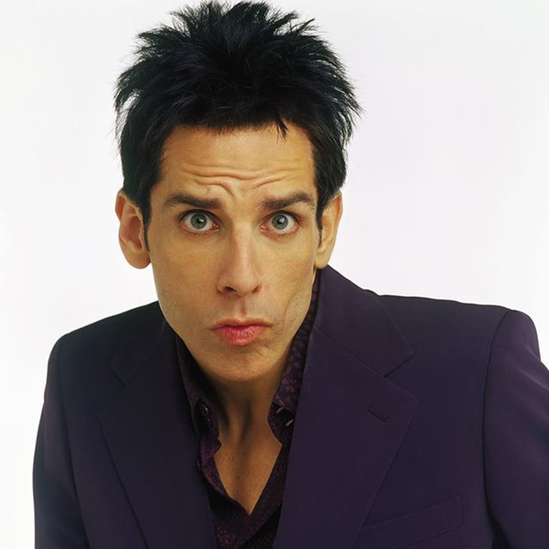
Ready for modeling (log reg, NOT runway)

Slide 10
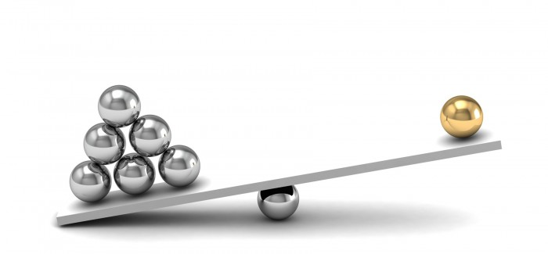
Class imbalance

Slide 11
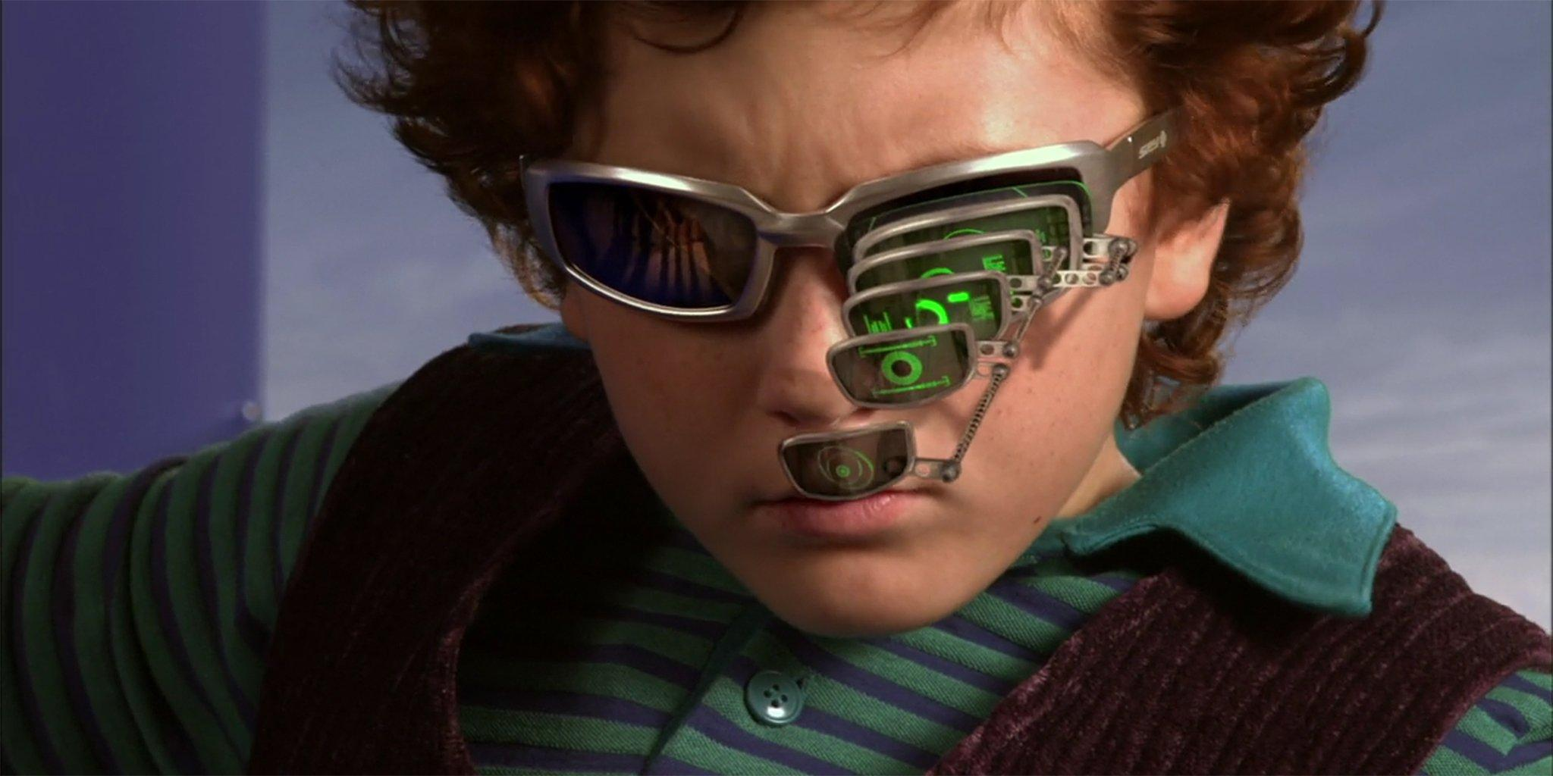
features

Slide 12
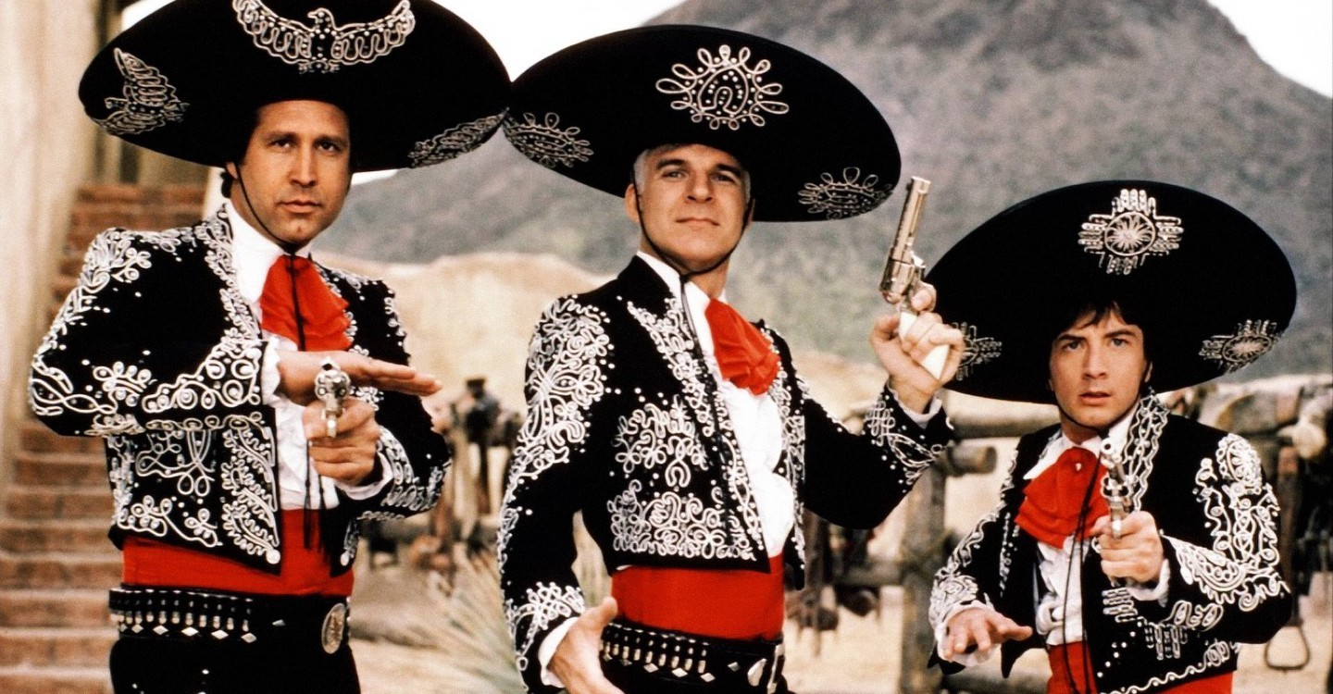
Notes:
3 stages of EDA

Slide 13
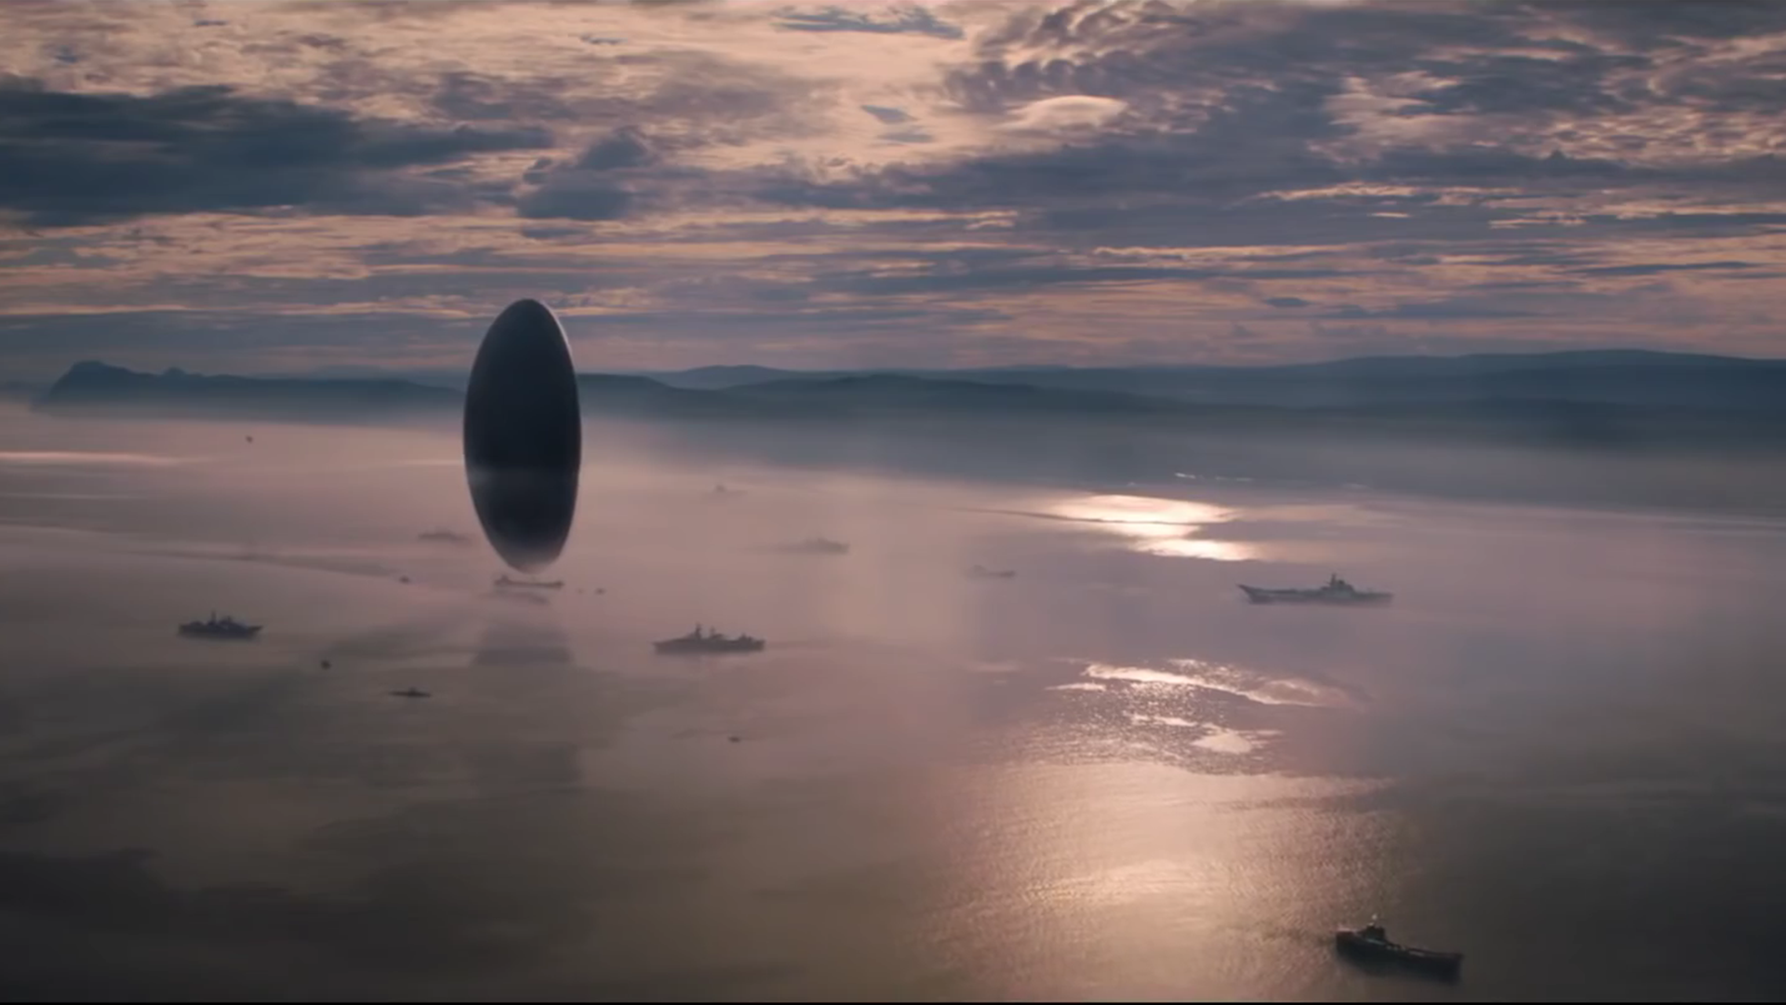
New phone who dis

Slide 14
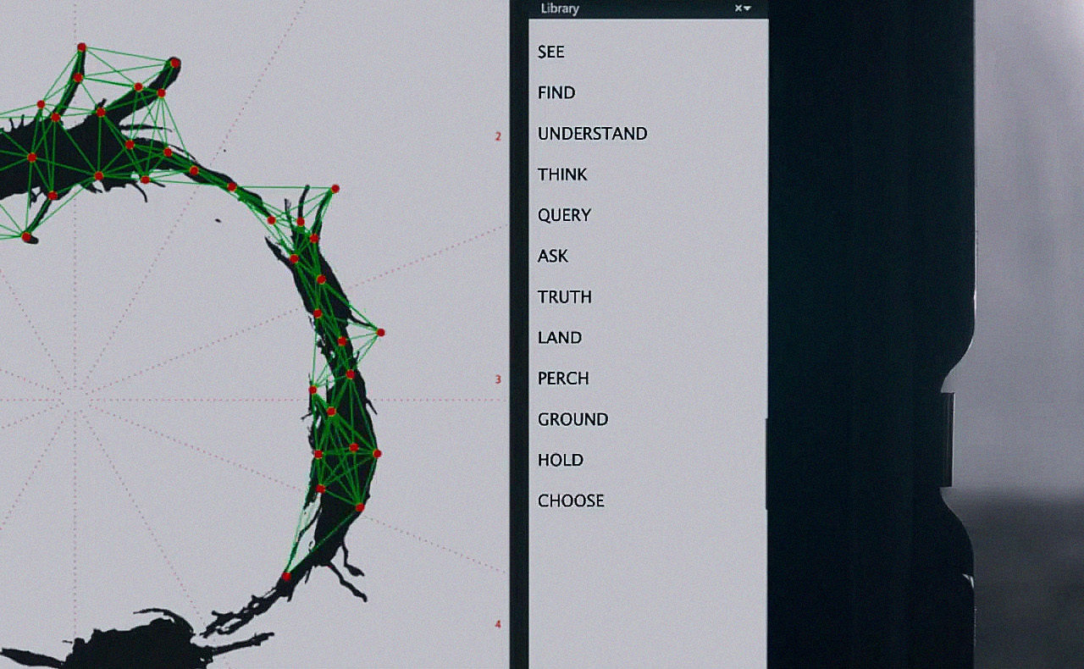
Lot of comparison
Apples to orange apples

Slide 15
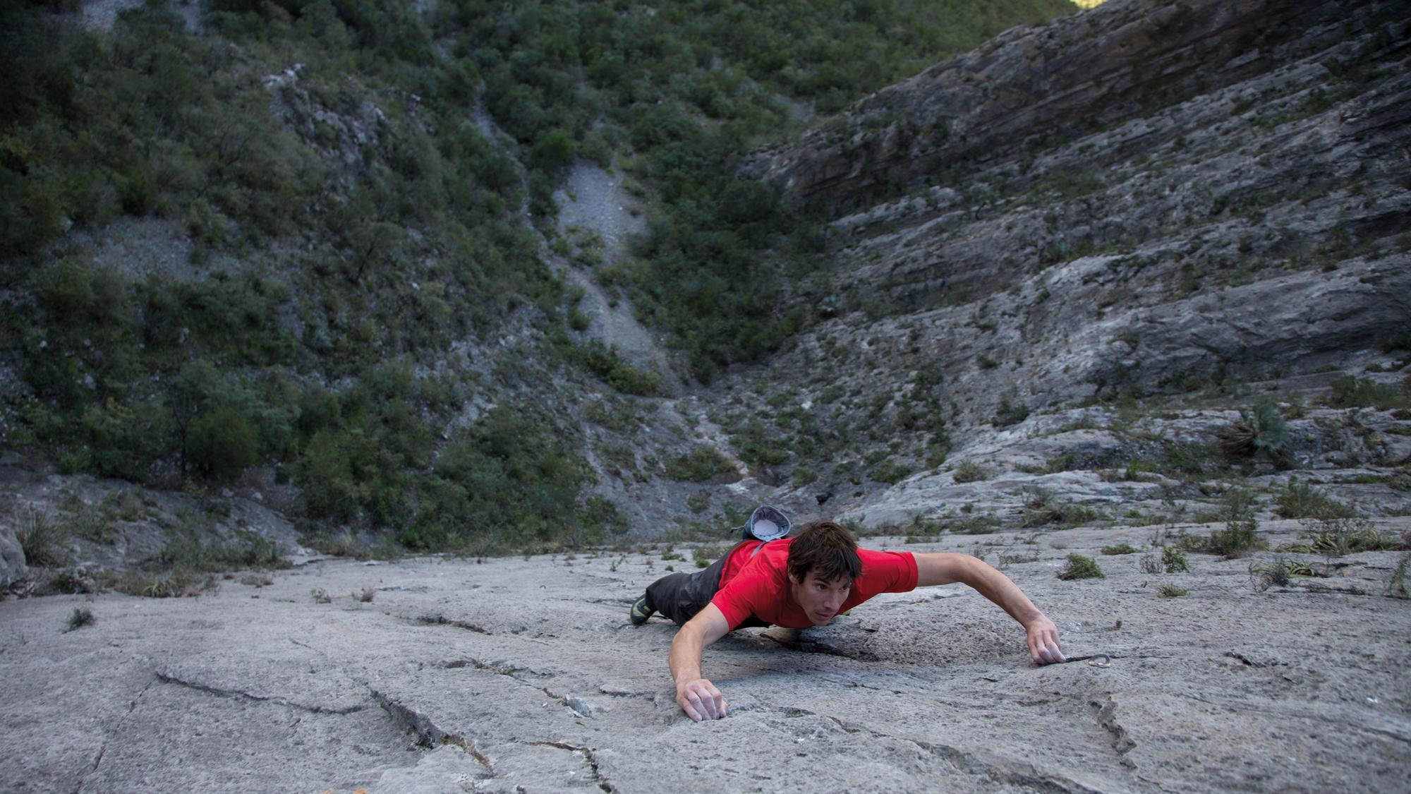
Notes:
To scale

Slide 16
Pic of handing over data

Slide 17
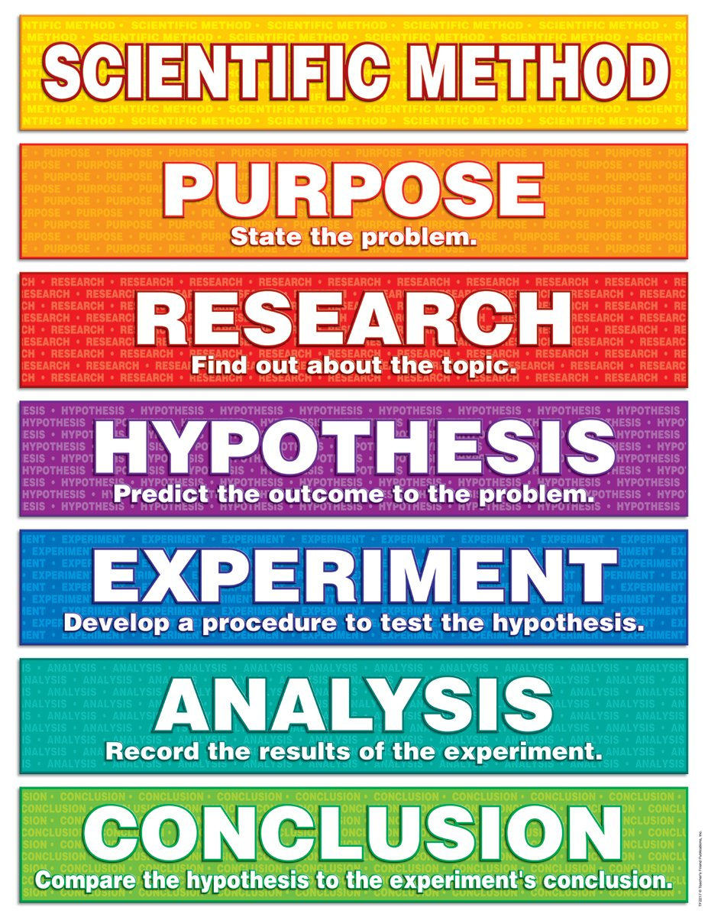
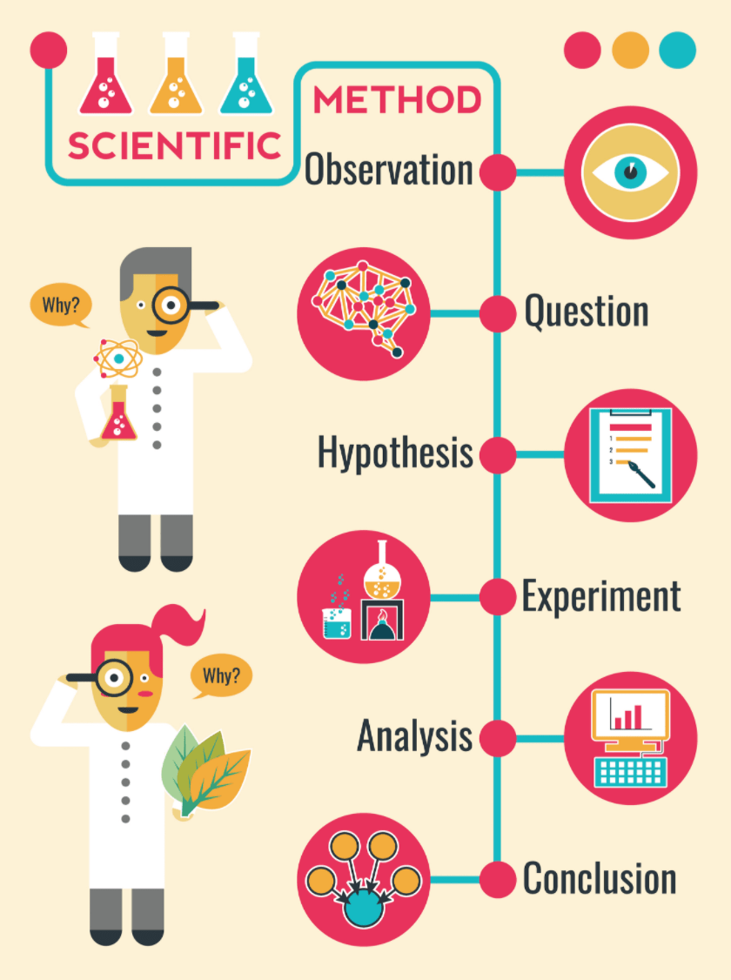
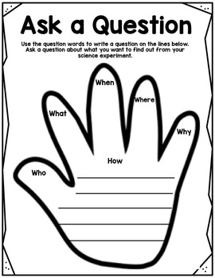

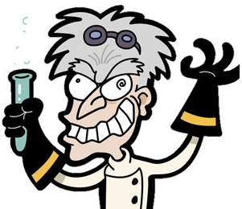

Slide 18

observe
Pic of reading
And note taking

Slide 19
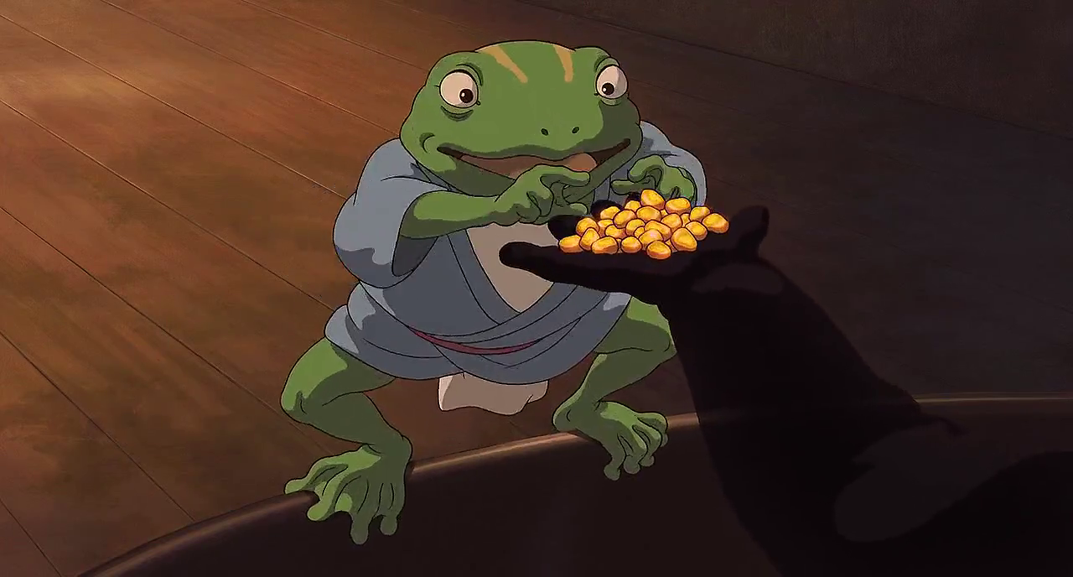
hypothesis
This data meets requirements for modeling
This data is worth the customer and my time
Notes:
This data meets requirements for modeling
This data is worth the customer and my time

Slide 20

Null hypothesis
poop

Slide 21
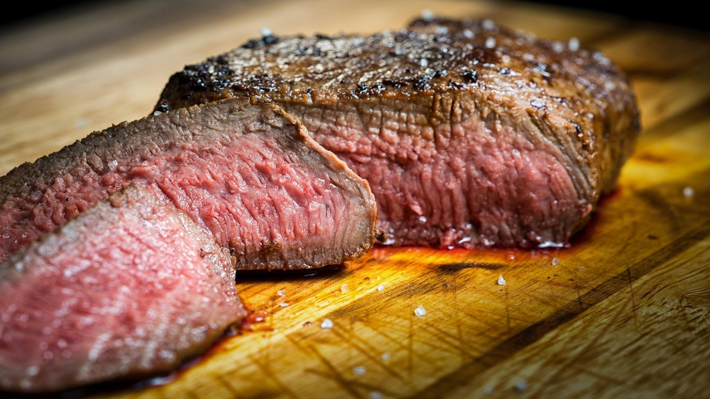
Experiment
Meat or group of scientists
Notes:
Experiment -- the meat of today’s talk

Slide 22
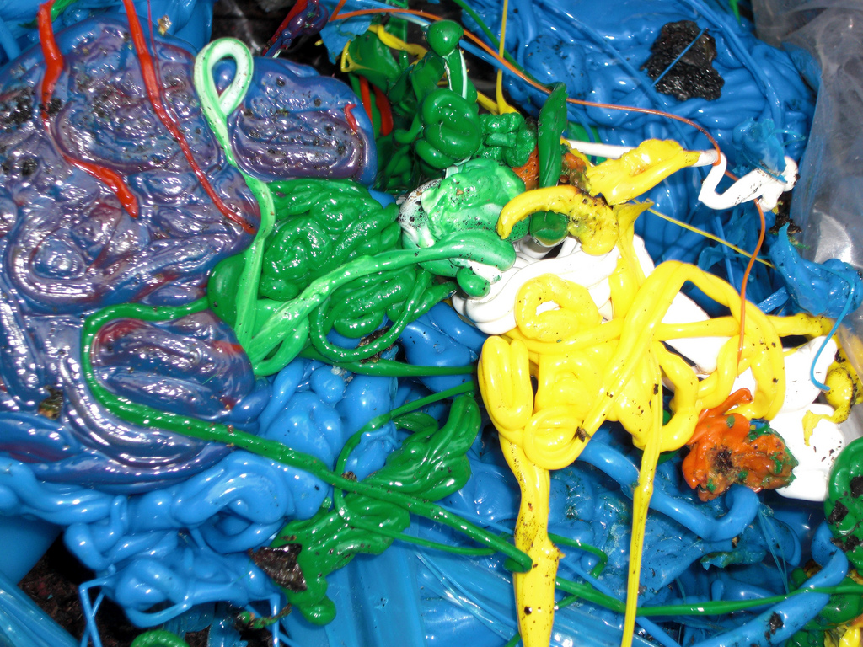
Feature vectors
Plastic into legos
Notes:
How do we turn a sea of text

Slide 23
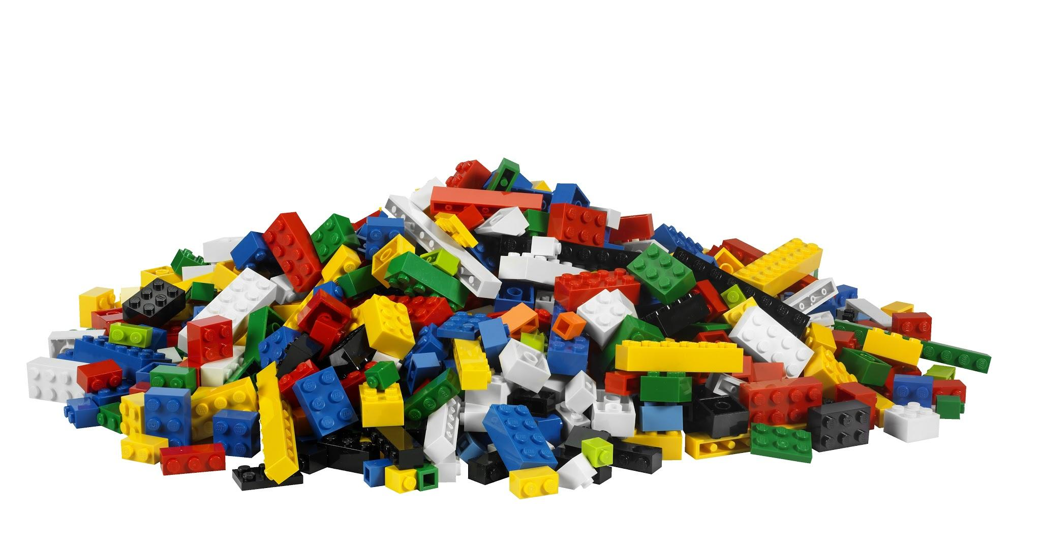
Notes:
Into structured blocks that have attributes to help us build something meaningful?

Slide 24
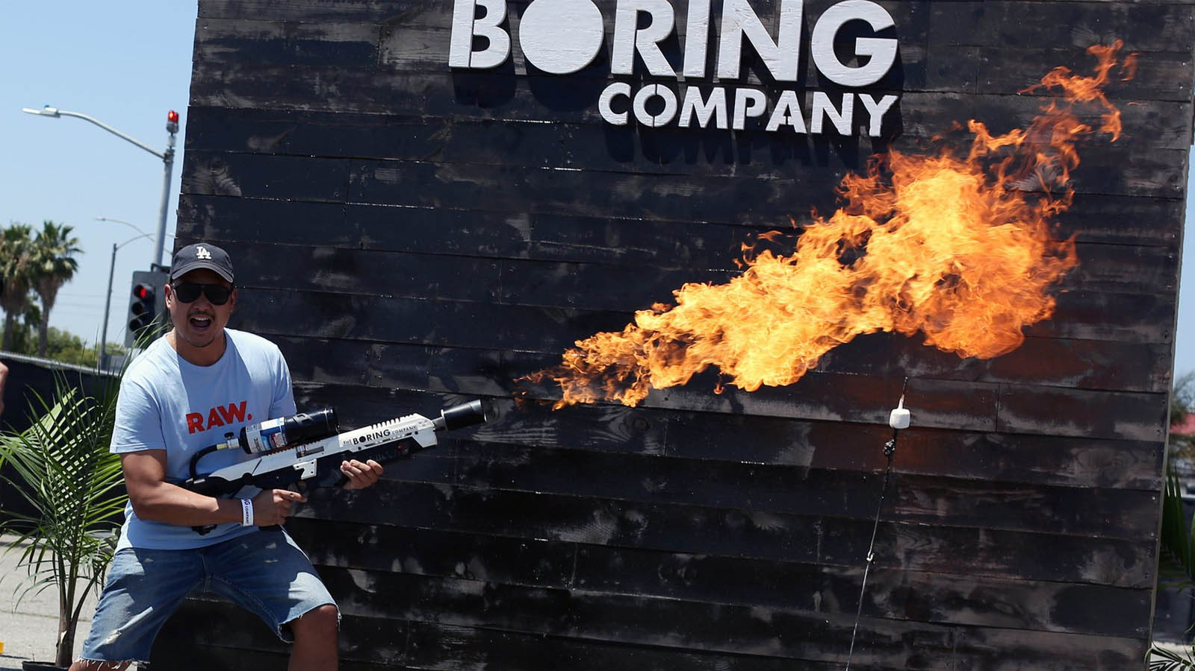
Notes:
What does a computer see?

Slide 25



when | eda | donuts | are | over | my | favorite | part | about | is | it | food
0 | 0 | 1 | 1 | 0 | 1 | 1 | 0 | 0 | 0 | 0 | 1
1 | 1 | 0 | 0 | 1 | 1 | 1 | 1 | 1 | 2 | 1 | 0
when | eda | donuts | are | over | my | favorite | part | about | is | it | food
0 | 0 | 1 | 1 | 0 | 1 | 1 | 0 | 0 | 0 | 0 | 1
1 | 1 | 0 | 0 | 1 | 1 | 1 | 1 | 1 | 2 | 1 | 0
when | eda | donuts | are | over | my | favorite | part | about | is | it | food
0 | 0 | 1 | 1 | 0 | 1 | 1 | 0 | 0 | 0 | 0 | 1
1 | 1 | 0 | 0 | 1 | 1 | 1 | 1 | 1 | 2 | 1 | 0
“Donuts are my favorite food.”
“My favorite part about EDA is when it is over.”

Slide 26
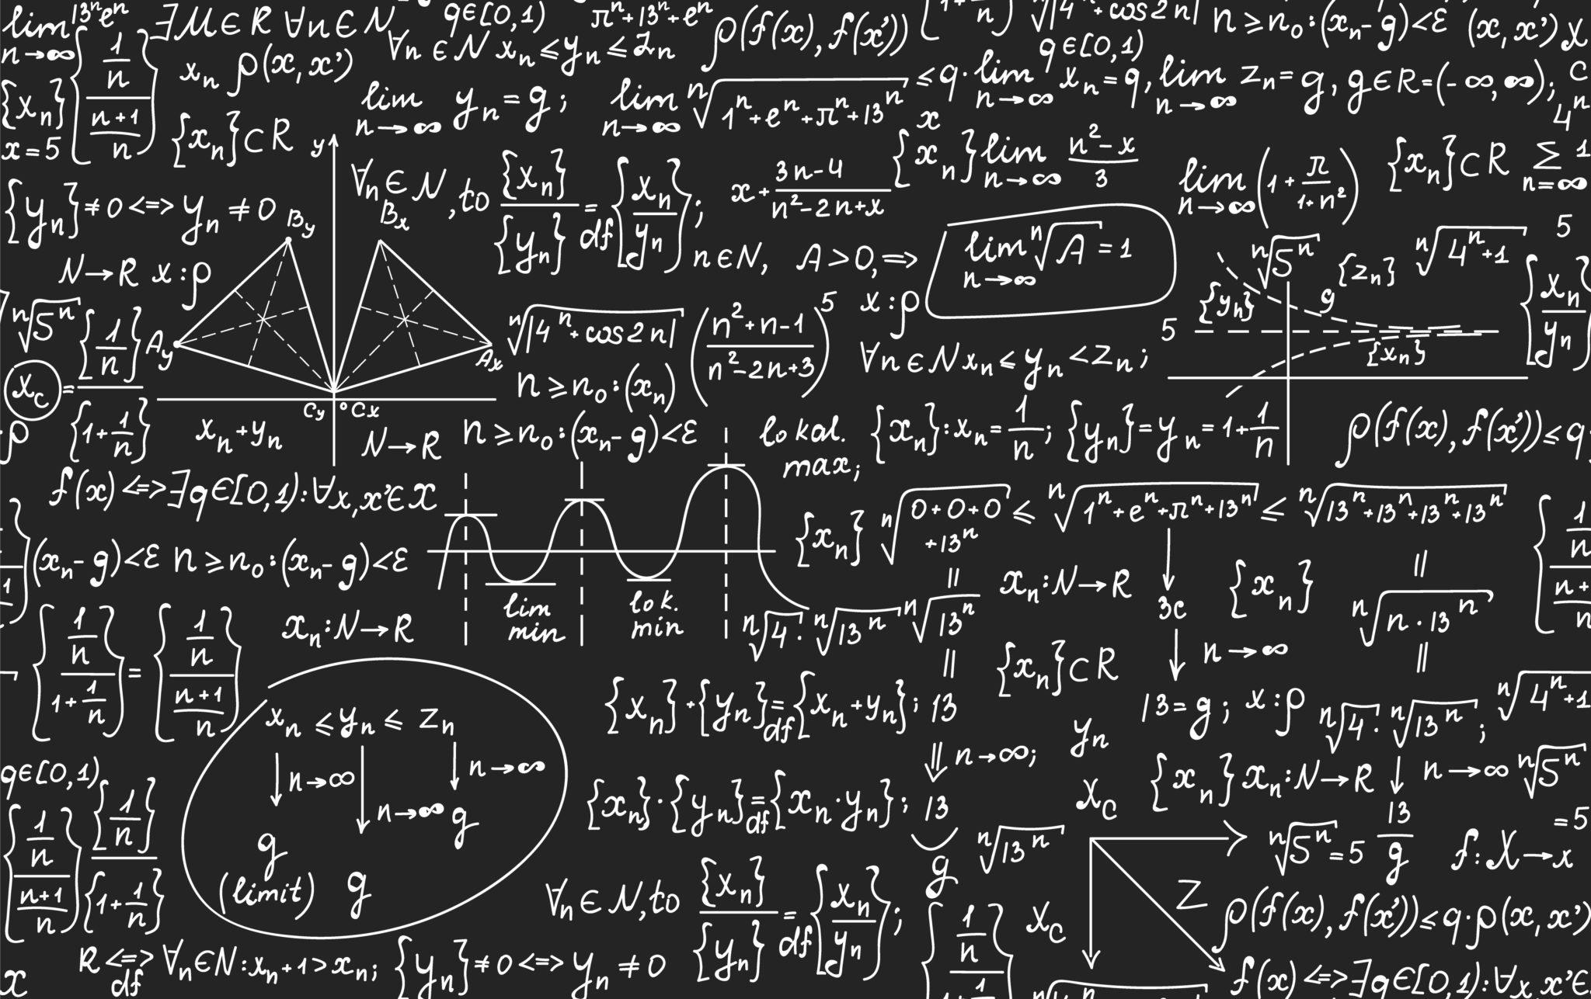
Feature vectors
Rows being counted
Top mid and bottom sections of feature counts

Slide 27
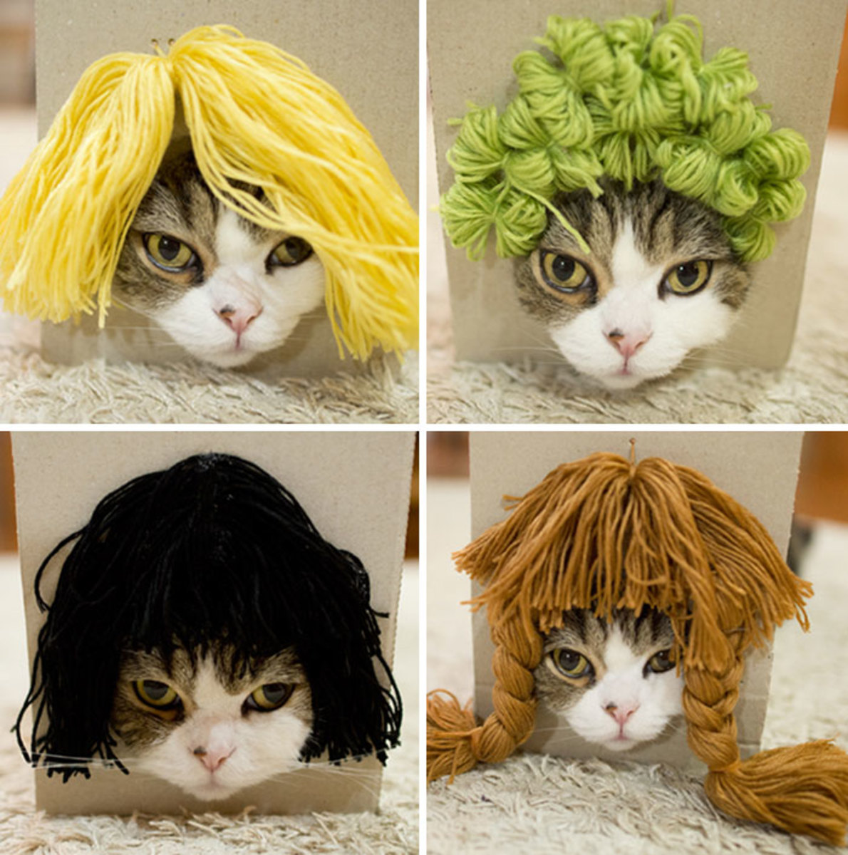

Slide 28

Word cloud

Slide 29

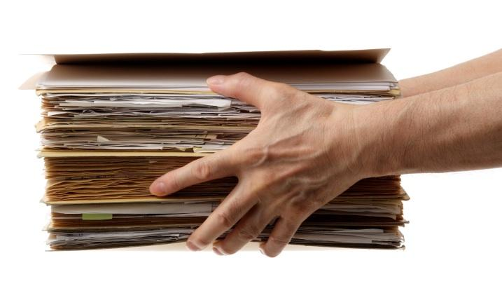

Slide 30
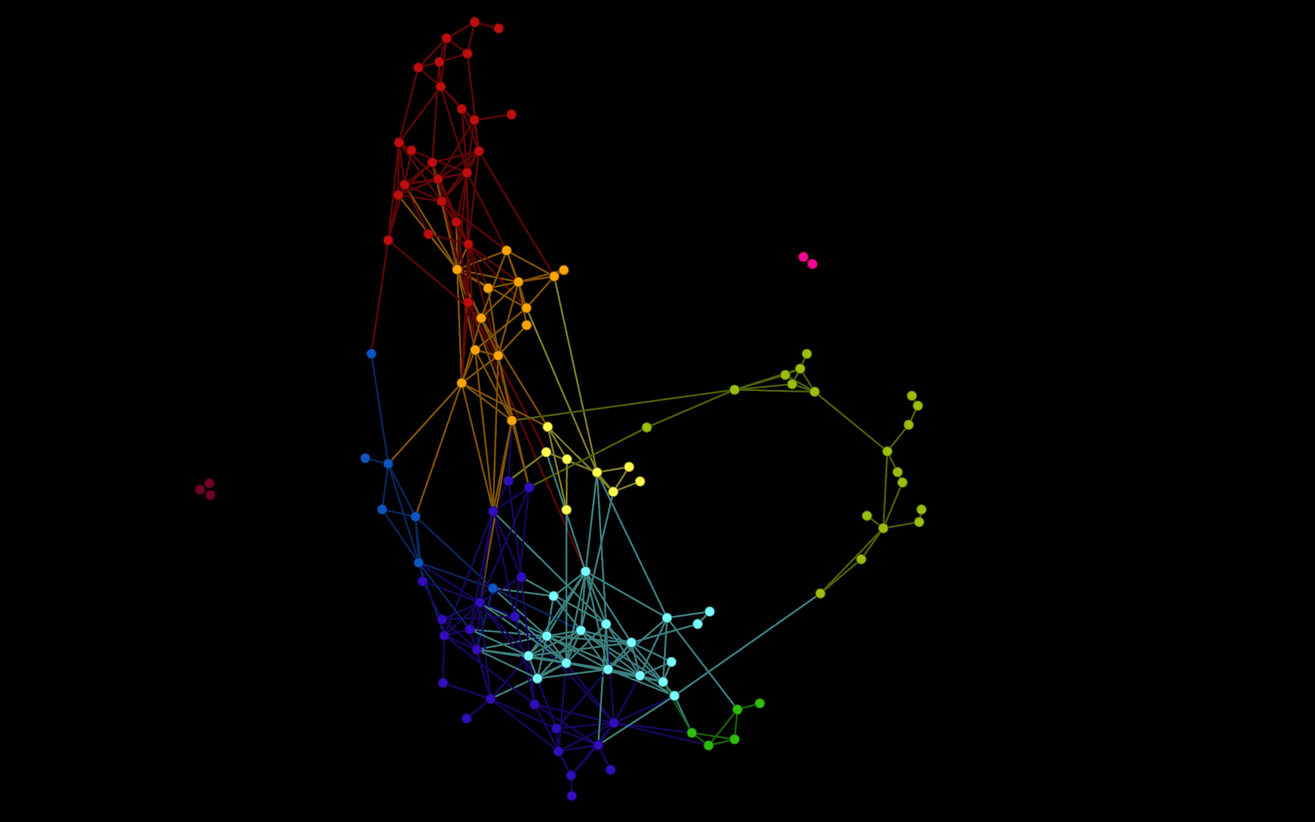
t-SNE

Slide 31
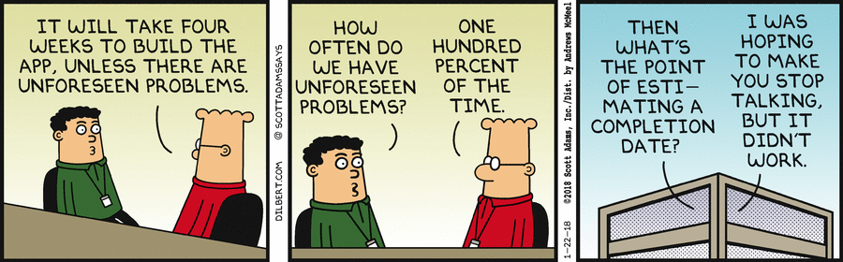

Slide 32

“We shall not cease from exploration
And the end to all our exploring
Will be to arrive where we started
And know the place for the first time.”
-T.S. Eliot-

